Slide 1

AI Medical Chatbot with RAG

Slide 2



Team Members
Saad Saddique
22-NTU-CS-1370
Hoor Shumail
22-NTU-CS-1347

Slide 3

Project Overview: Intelligent Medical Assistant
What it is
How it works
An intelligent assistant for medical queries. It uses a Retrieval-Augmented Generation (RAG) pipeline.
It combines Large Language Models (LLMs) with domain-specific knowledge retrieval. This ensures accurate and explainable answers.
Key technologies
Leveraging Hugging Face Transformers and LangChain. Custom medical documents provide crucial context.

Slide 4
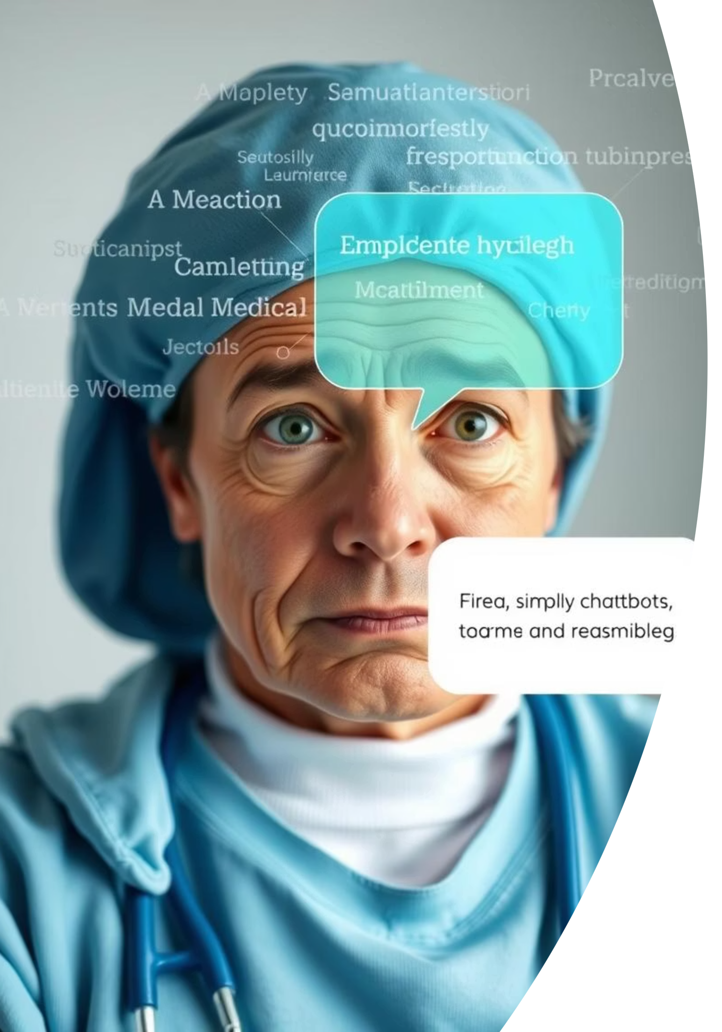
Addressing the Need for Trustworthy Information
Traditional chatbots often fall short in medical accuracy. Misinformation is dangerous in healthcare. There is a critical need for verified, trusted medical knowledge. Our system retrieves custom-curated data. It generates reliable, relevant responses, fostering user trust.

Slide 5

Our Core Objectives
1
RAG Pipeline Development
Build a functional RAG pipeline using LangChain and Hugging Face.
2
Medical Document Integration
Integrate domain-specific medical documents into a FAISS vector store.
3
Real-time Conversational AI
Enable conversational interaction with real-time question answering.
4
Comprehensive Tutorial
Provide a detailed tutorial for replication and learning.

Slide 6

Methodology: Building the Chatbot
Document Preparation
Preprocess "The Gale Encyclopedia of Medicine" documents.
Embedding & Indexing
Generate embeddings using SentenceTransformers. Store them in FAISS.
RAG Pipeline Construction
Build a retrieval and generation chain with LangChain.
Chatbot Interface Design
Develop a simple frontend using Streamlit or Gradio for Q&A.

Slide 7
Key Technologies Employed
Models & Frameworks
Data & Language
Language Models: Hugging Face Transformers (LLaMA 2, Mistral).
Embedding Models: SentenceTransformers.
Vector DB: FAISS.
Frameworks: LangChain, Streamlit/Gradio.
Programming Language: Python.

Slide 8




Expected Outcomes: Impact and Innovation
Working Prototype
A functional medical chatbot prototype based on real data.
Reproducible Tutorial
A clear tutorial for building a RAG chatbot.
Improved User Trust
Accurate, source-grounded medical answers.

Slide 9
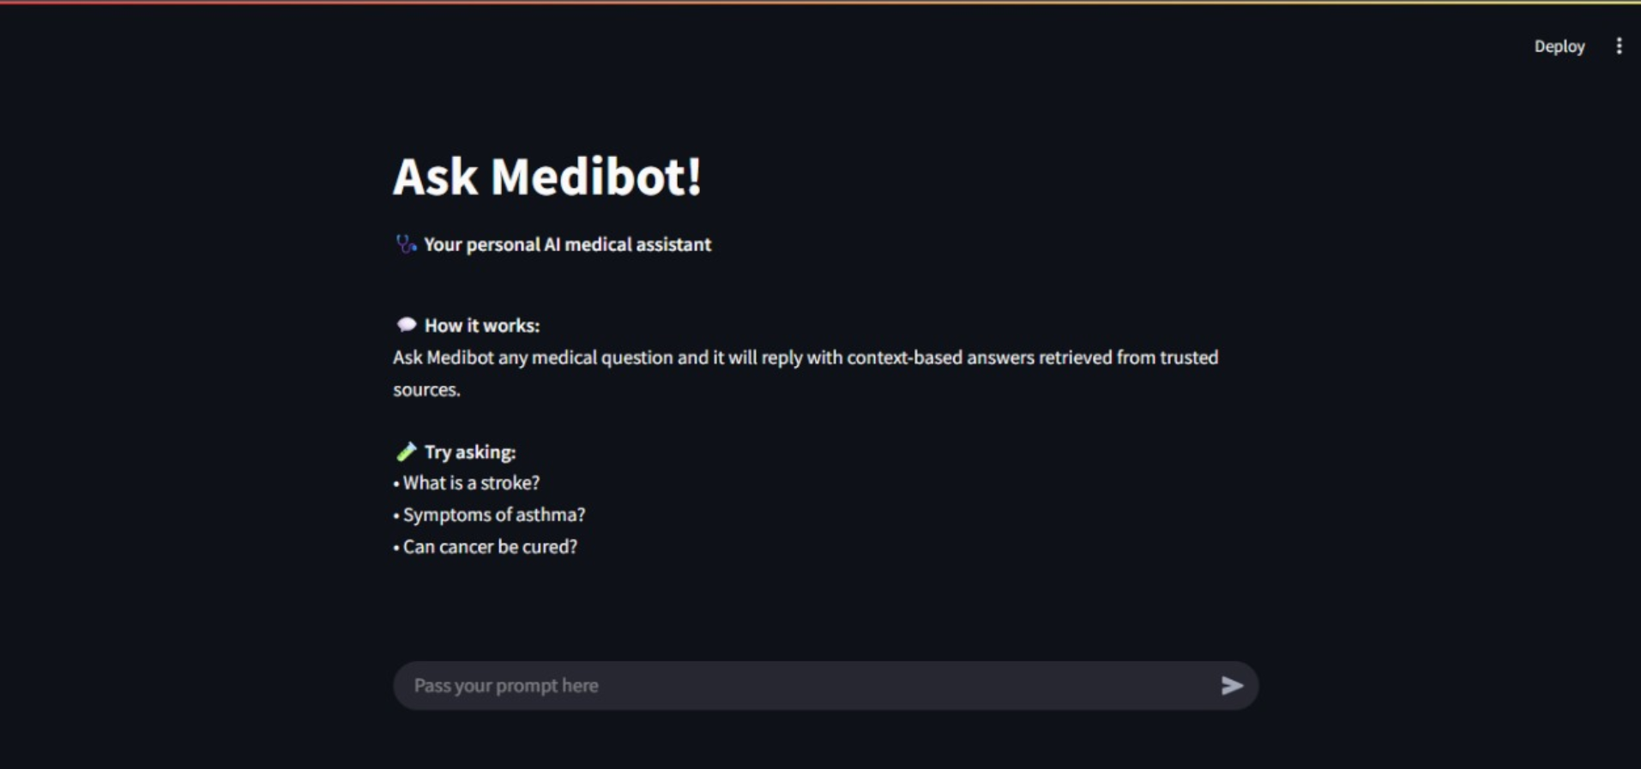

Slide 10
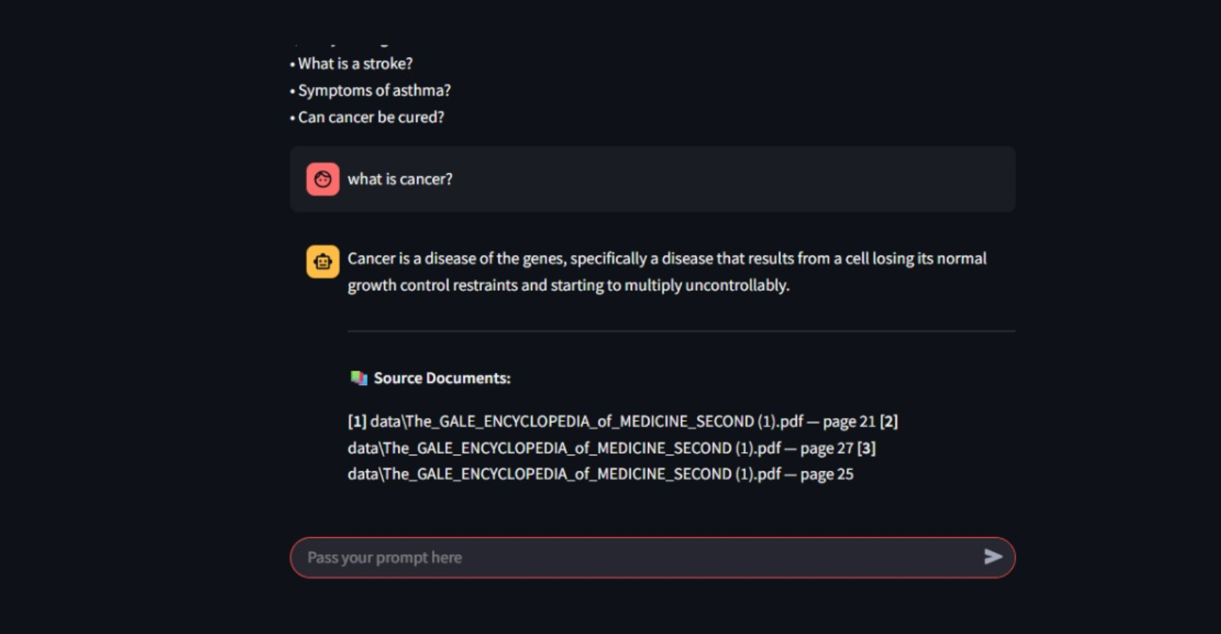

Slide 11
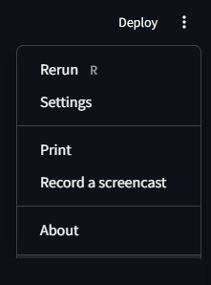

Slide 12
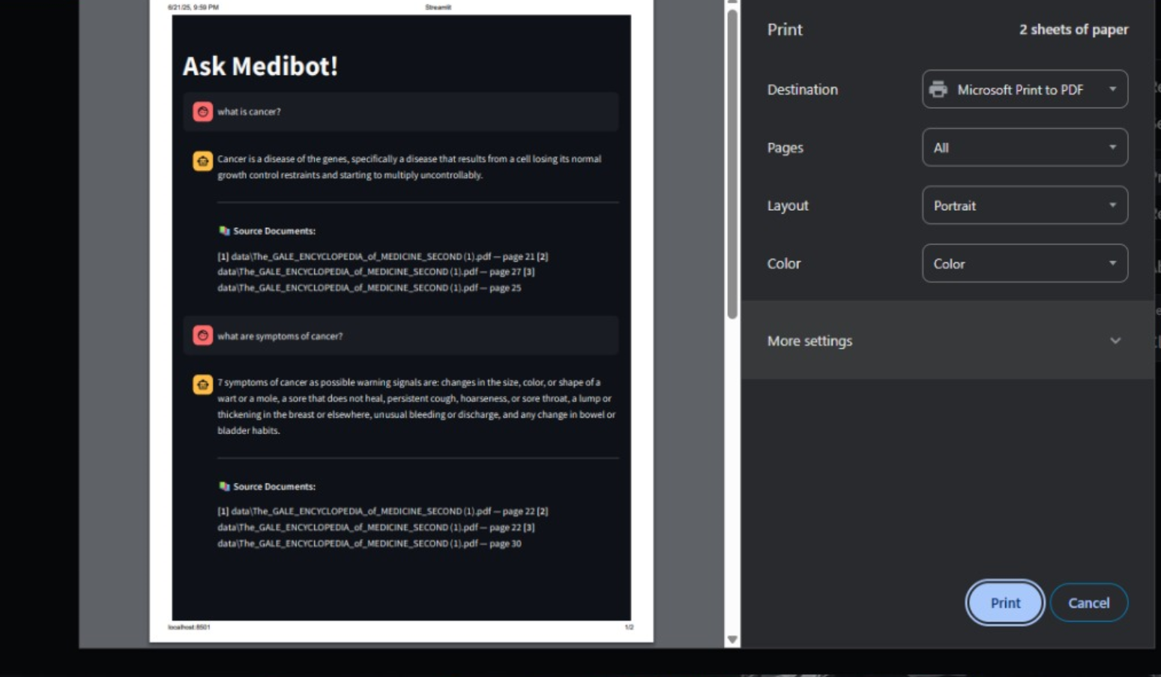

Slide 13
